Slide 1
Technical Analysis
Feb. 07, 2017
Tian Run Yang, Cheng Zhou, Shiyuan Wu, Yida Wang, and Mengtian Ni

Slide 2
Presentation Outline
Technical Analysis definition
Indicators & Oscillators
Portfolio Composition
Portfolio performance comparison
Technical analysis vs. Fundamental analysis

Slide 3
What is Technical Analysis
Equity analysis methodology for forecasting the direction of prices using historic data, mostly based on price and volume
Price and volume reflects the collective behaviour of buyers and sellers
Assumptions:
market prices reflect both rational/irrational investor behaviour (efficient market hypothesis does not hold)
investor behaviour is reflected in trends and patterns will repeat and can be used to forecast prices

Slide 4
Price Indicators – Moving Average
Average of closing price over a specified period (long term & short term trend lines)
Smooth out fluctuation & provide market trend
Long time period will have a smoother curve

Slide 5
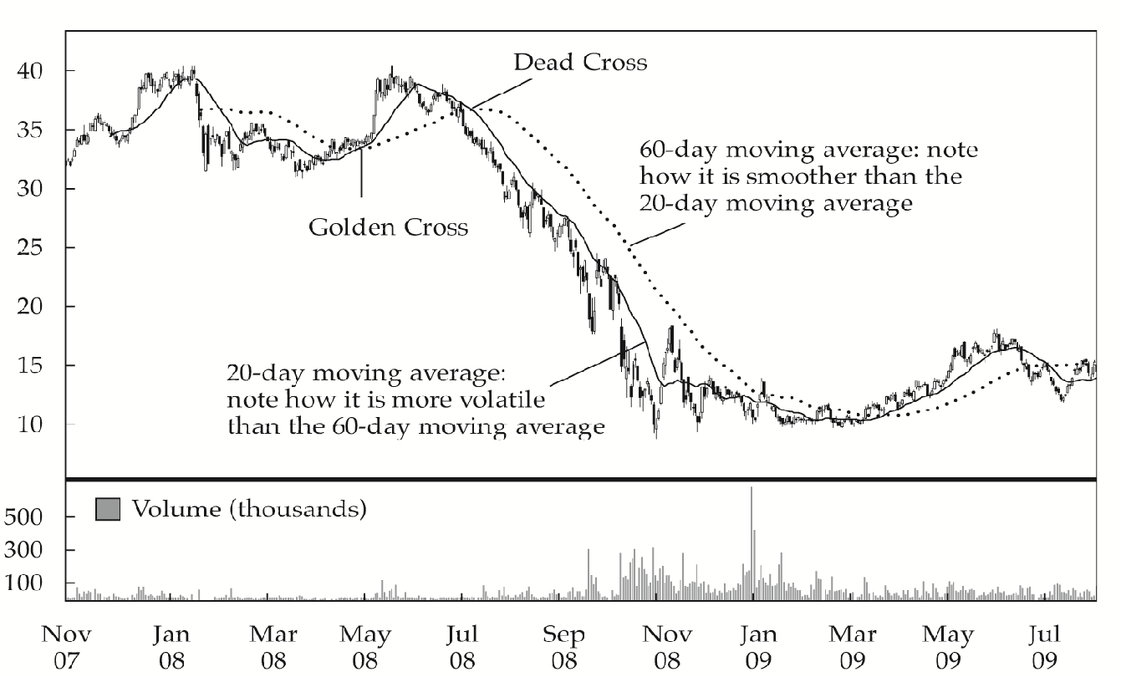
Price Indicator – Moving Average
Notes:
Indicators are used in two main ways: to confirm price movement and the quality of chart patterns, and to form buy and sell signals.

Slide 6
Momentum Oscillators – Relative Strength Index
Ratio of total price increase to total price decrease over a selected number of periods
Oscillate from 0 ~ 100
>70 : Overbought – price is too high, and it is likely to decrease
<30: Oversold – price is too low, and it is likely to increase
Notes:
Reference: CFA Investments Chapter 12
Oscillator indicators have a range, for example between zero and 100, and signal periods where the security is overbought (near 100) or oversold (near zero).

Slide 7
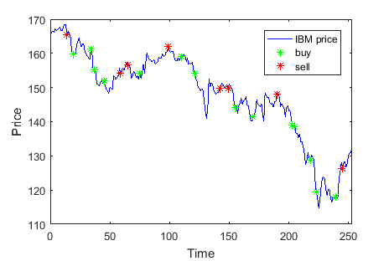
Momentum Oscillators – Relative Strength Index

Slide 8
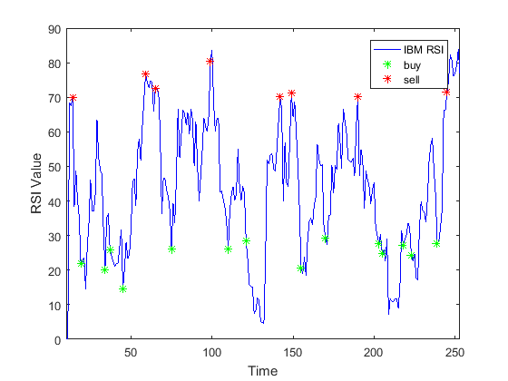
Single Stock Technical Analysis

Slide 9
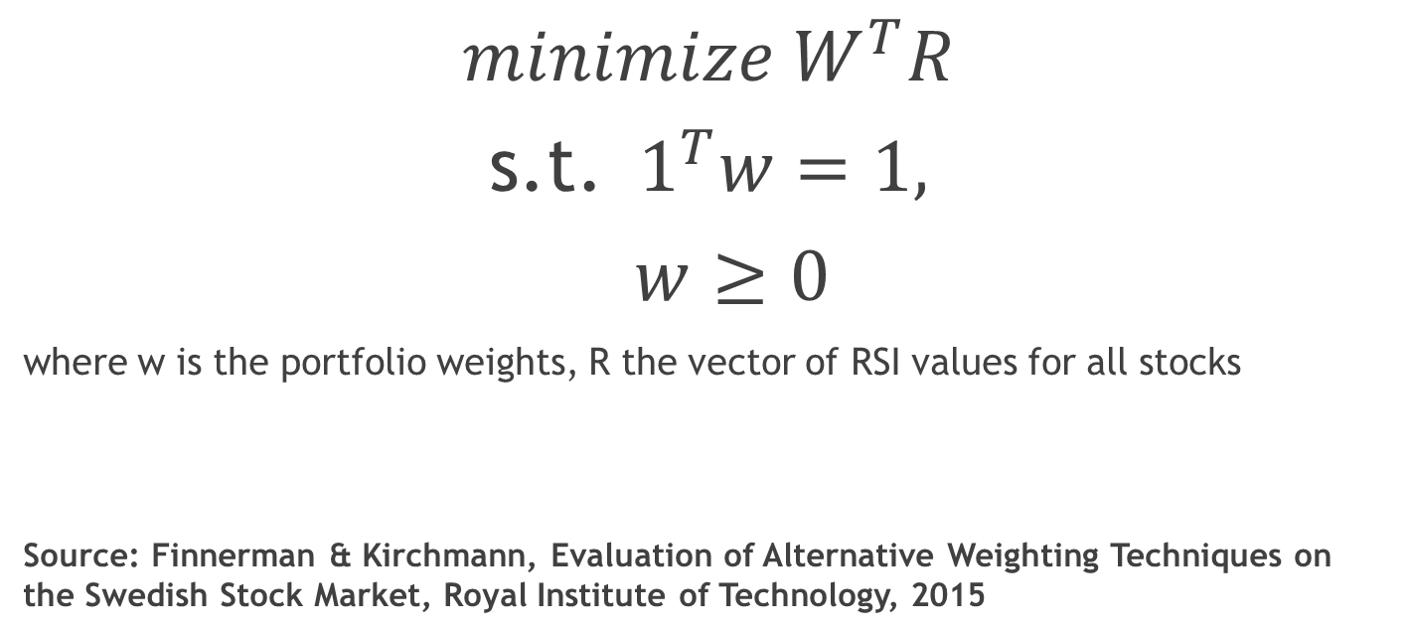
RSI Weighting
$$minimize W^{T}R$$
s.t. $1^{T}w=1,$
$w≥0$
where w is the portfolio weights, R the vector of RSI values for all stocks
Source: Finnerman & Kirchmann, Evaluation of Alternative Weighting Techniques on the Swedish Stock Market, Royal Institute of Technology, 2015

Slide 10
Comparison with Fundamental Analysis
 | Fundamental Analysis | Technical Analysis
Definition | Intrinsic value of an asset | Price movement and patterns to predict future price movement
Data | Economic reports, news, industry statics | Share price, trading volume
Decision Making | Buy: price < intrinsic value Sell: price > intrinsic value | Buy: predict a price has a high probability moving to profit
Trader | Long term trading | Swing trader and short term day traders
Time Horizon | Days, weeks or even months | Days, minutes. Can be long term
Concepts | Report expectation vs. actual outcome Current news event vs. historical events | Trend lines, support & resistance, Dow Theory, price pattern

Slide 11
Comparison with Fundamental Analysis
Technical Analysis only uses trading volume and share prices to project a target price, not concerned with trader's reason for trading, but only that the trades have occurred.
Advantage of technical:
Actual price and volume data is observable whereas fundamental is subject to assumptions or restatements, and may not be available for all assets (i.e.. currency & commodities)-
Applied to asset prices w/o future cash flows (dividend and interest)
Financial statement fraud: price & volume reflect the true value of the company
Disadvantage
Price & volume probably doesn’t reflect the true supply & demand (i.e. illiquid markets and markets subject to outside manipulation)

Slide 12
Conclusion
We discussed technical analysis:
Simple Moving Average
Relative Strength Indicator
In depth look at RSI and portfolio optimization
Performance comparison between RSI balanced portfolio, equal weighted portfolio and SP500
Comparison of technical analysis and fundamental analysis

Slide 13

Q & A

Slide 14

Thank you!

